Slide 1


Health Advocate
Website Demo for LCIC and NTIC
Carmen Terry
Health and Wellness Coordinator
Notes:
Welcome to the online tutorial for the health advocate website.

Slide 2


Agenda
Registration or Logging in
Where to start
Notes:
We will begin with Registration or Logging in

Slide 3


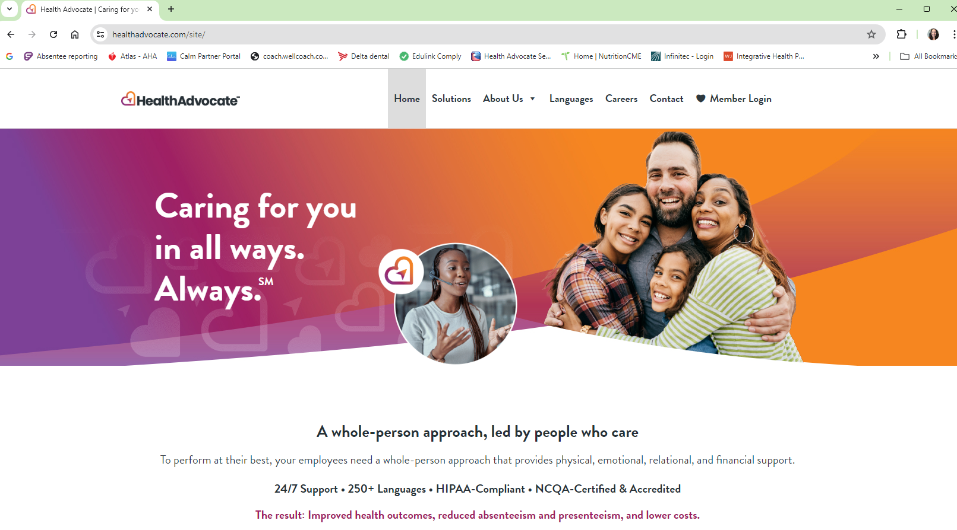
Registration or Logging in
Notes:
Goi to healthadvocate.com main page and click over on the member login on the far right.

Slide 4
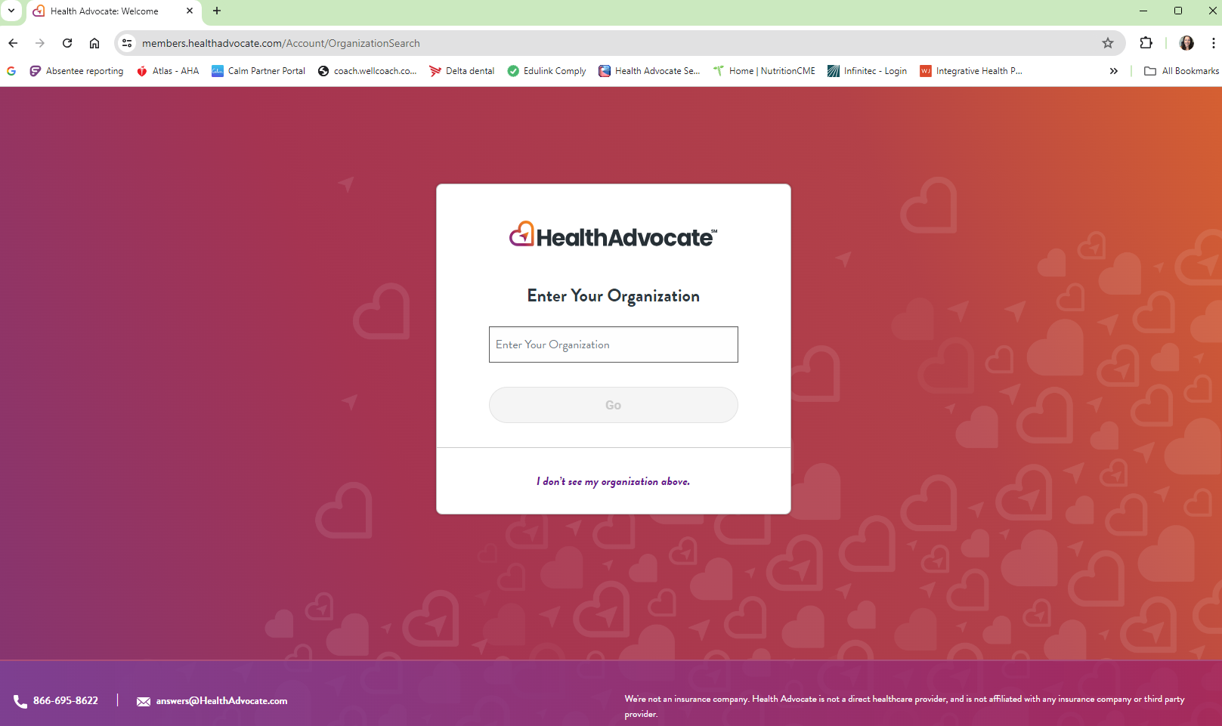
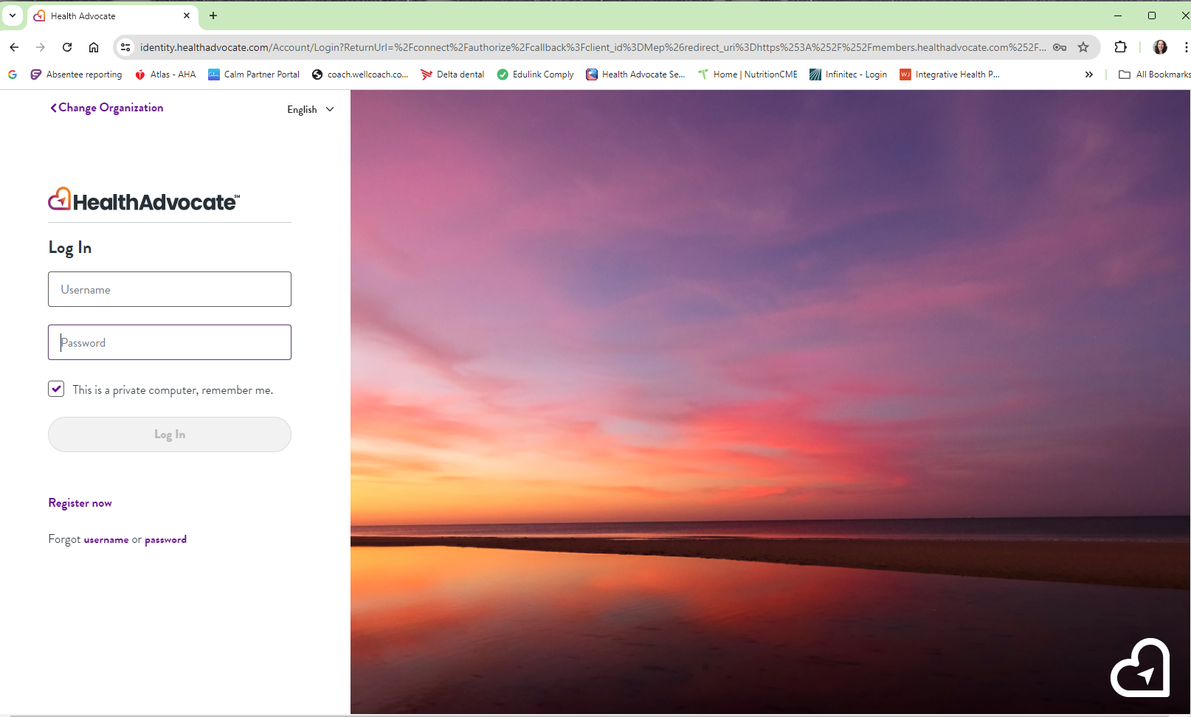
Organizations:
Lycoming County Insurance Consortium
Or
Northern Tier Insurance Consortium
Notes:
The organization you want to choose will be based on who you are insured through, either the Lycoming County Insurance Consortium or Northern Tier Insurance Consortium.

Slide 5
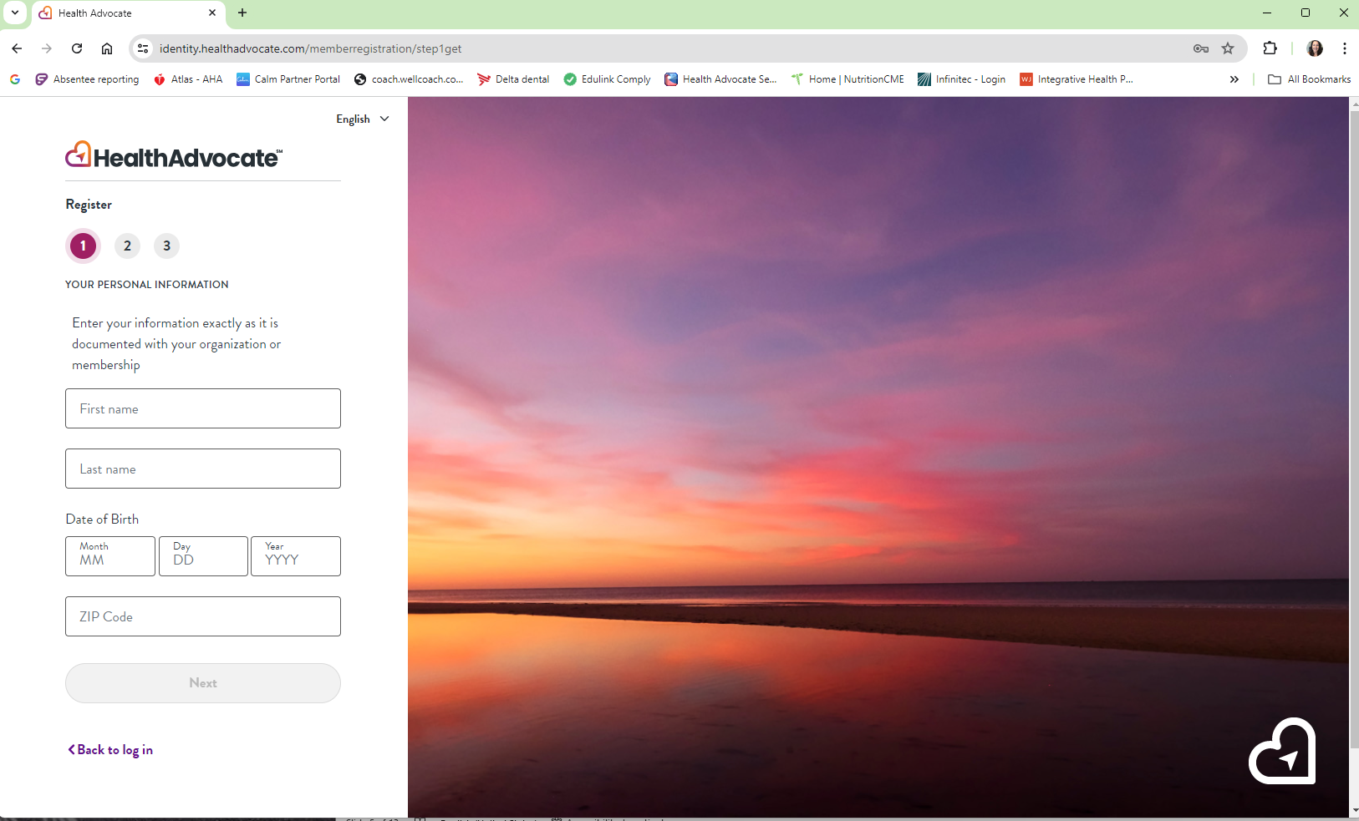
If you are new to the whole program you must register.
Fill in all the information and hit next.
You will be able to create a username and a password. Then you will be asked to create security questions.
Once you register, go to your email to verify your account.
This will be the same username and password you can use on the app.
Notes:
If you are new to the program, you must use the register button. Fill in all the information. It will then prompt you to pick a username and password of your choosing. You will be asked to choose from security questions. Once you are finished, it will send you an email to verify your account. Then you can login on the website or the app using the username and password you created.

Slide 6
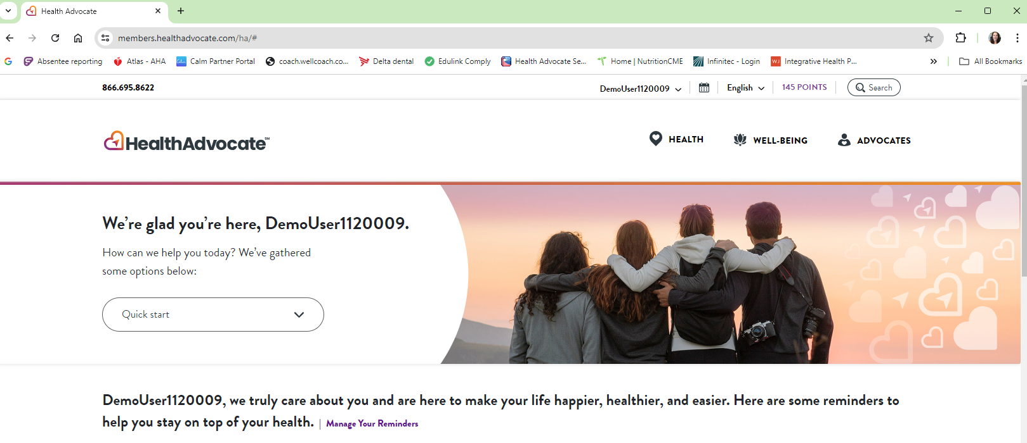
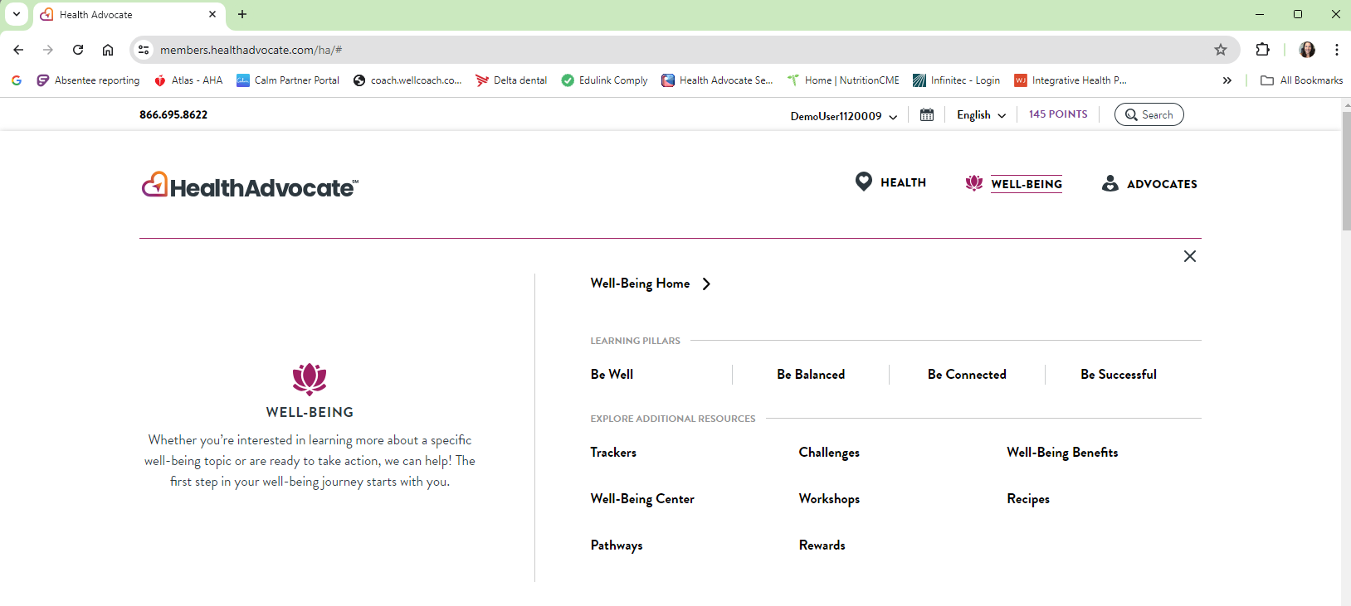
This is your home page for LCIC
On the home page for NTIC, you will only see Wellbeing.
Notes:
Whether you are new or veteran, this is the home page. This home page is for LCIC which includes Health and Advocacy. If you are part of NTIC you will see only Well-being. If you click on Well-being, then you can be taken to anything in the website, such as trackers, challenges, pathways, workshops, and rewards. If you click on Rewards, it will show you your health and wellbeing program in full. We will click on trackers to show you what those look like.

Slide 7
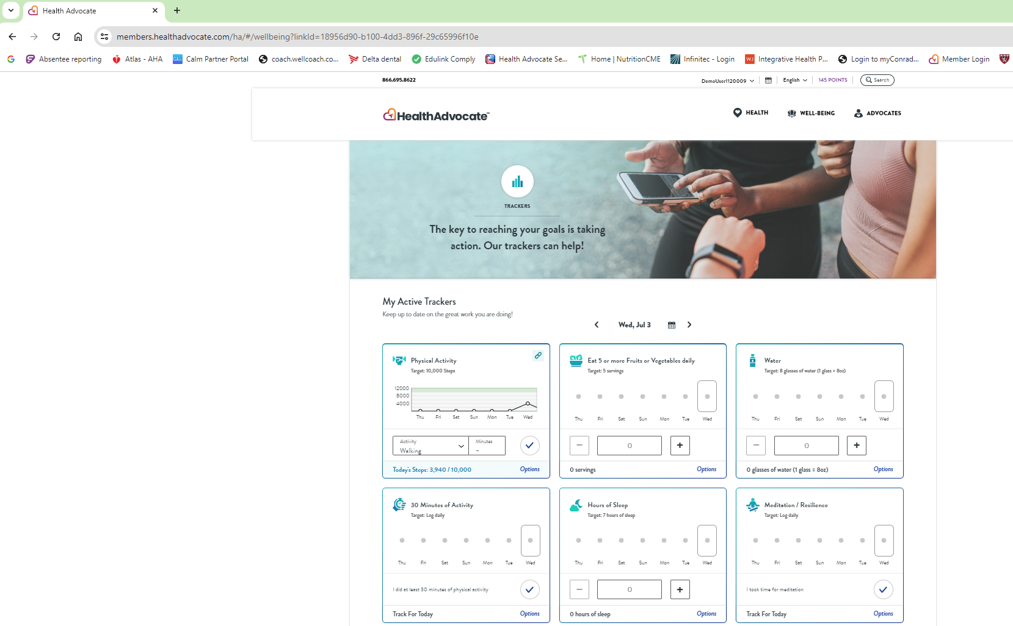
Trackers
Notes:
Trackers can be used to get points daily and for some trackers weekly. You can input all trackers all at once and then switch days to add data from other days. You can only go backwards in time to input data. If you scroll down the page, you can add certain trackers to your account. For example if you want to keep track of your mood, you can add that tracker to your page. Keep in mind not all trackers give you points.

Slide 8
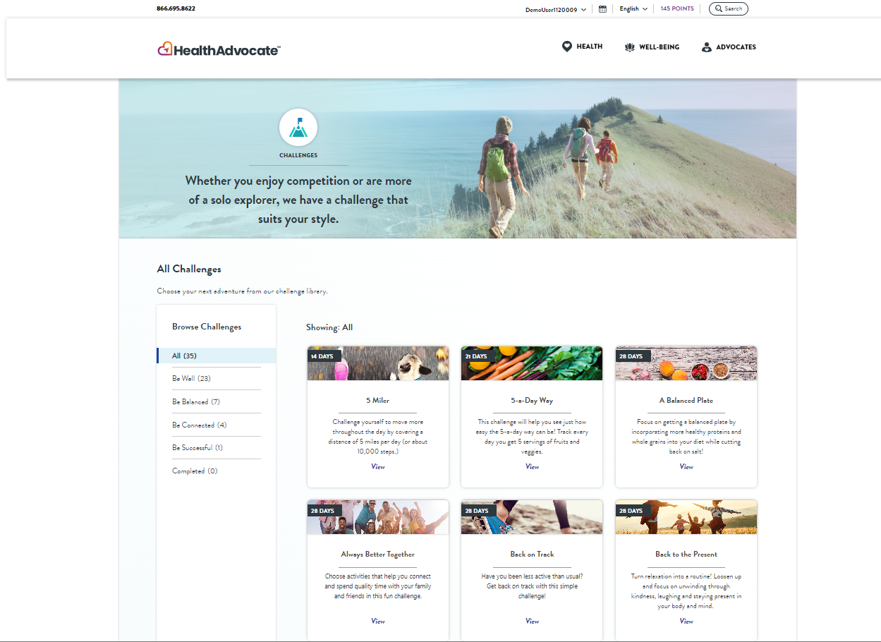
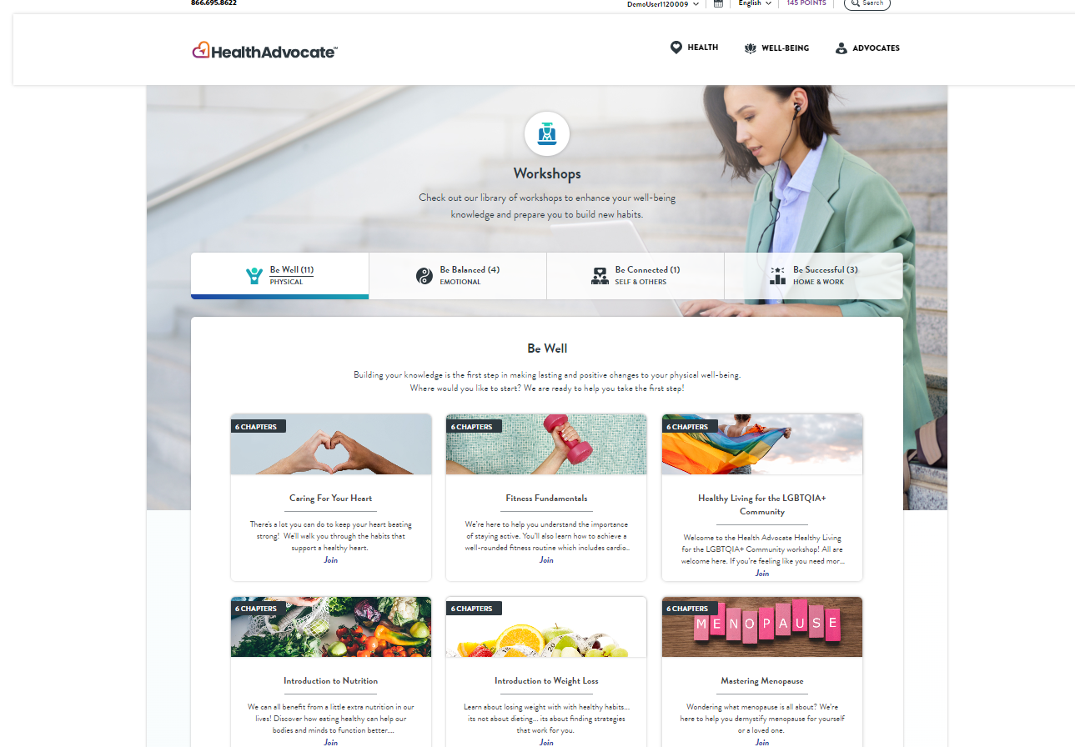
Notes:
From Wellbeing you can also choose challenges and workshops. Challenges are personal challenges that you can do yourself. Certain times of the year, you will be able to enter group challenges set up by your wellness coordinator.
You can also choose workshops and by completing each educational workshop in a short amount of time, you will receive points.

Slide 9
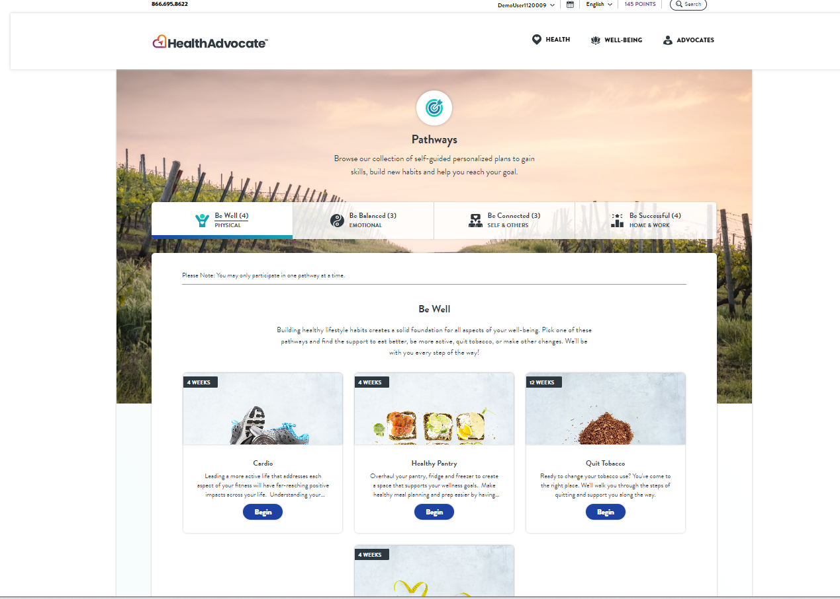
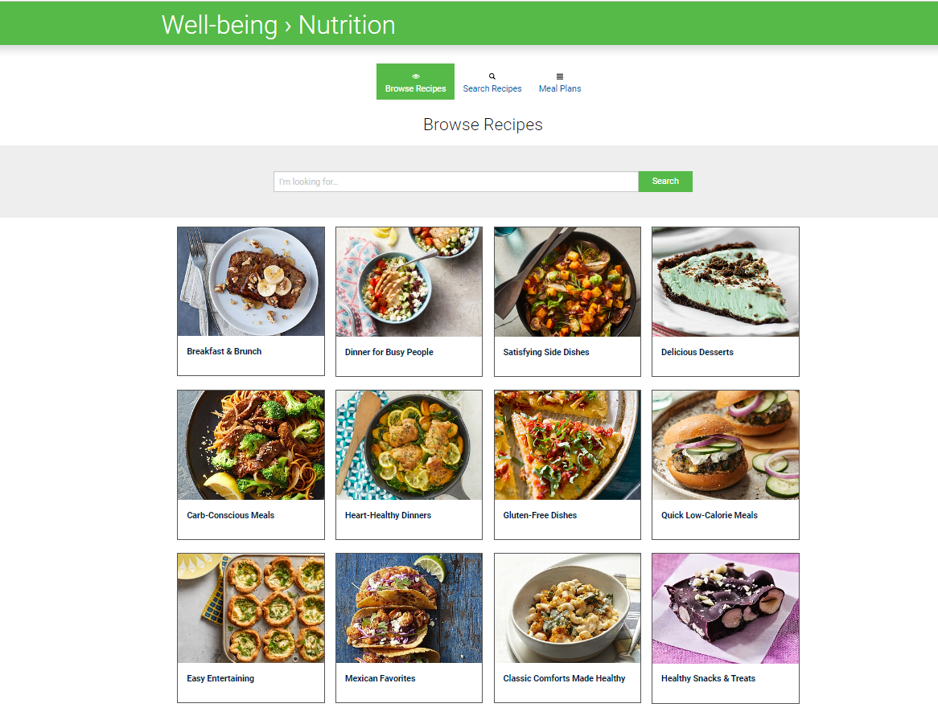
Notes:
Two other main things you can use from the Well-being tab is Pathways which are 4 week programs you can complete for points or the Nutrition site on health advocate. There are many recipes and several meal plans you can choose from on the site. You can also type in any dietary restrictions and it will bring up only those recipes that are helpful for you. If you haven’t tried the nutrition site of health advocate please explore this option!

Slide 10
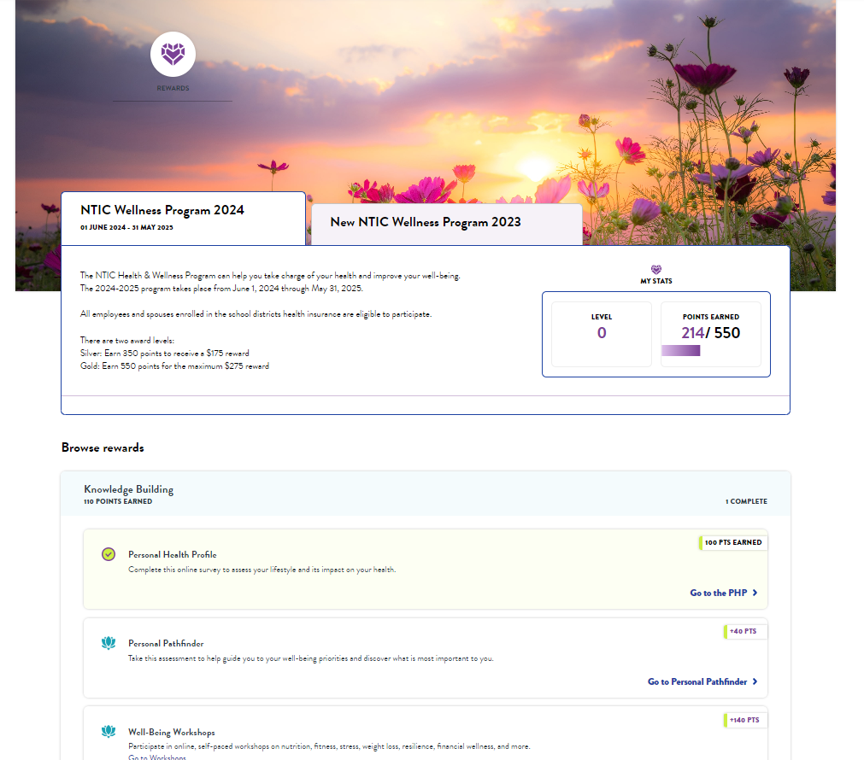
Notes:
And if you click on Rewards from the Well-being tab, it will bring up the whole program, here you can see the NTIC wellness program, with the number of points, the levels and if you scroll down the page you will be able to click on different items for points. Here you can see the completed personal health profile as it has a checkmark next to it and the points earned for completing.

Slide 11


The way to get started is to quit talking and begin doing.
Walt Disney

Slide 12


Thank you

